Slide 1
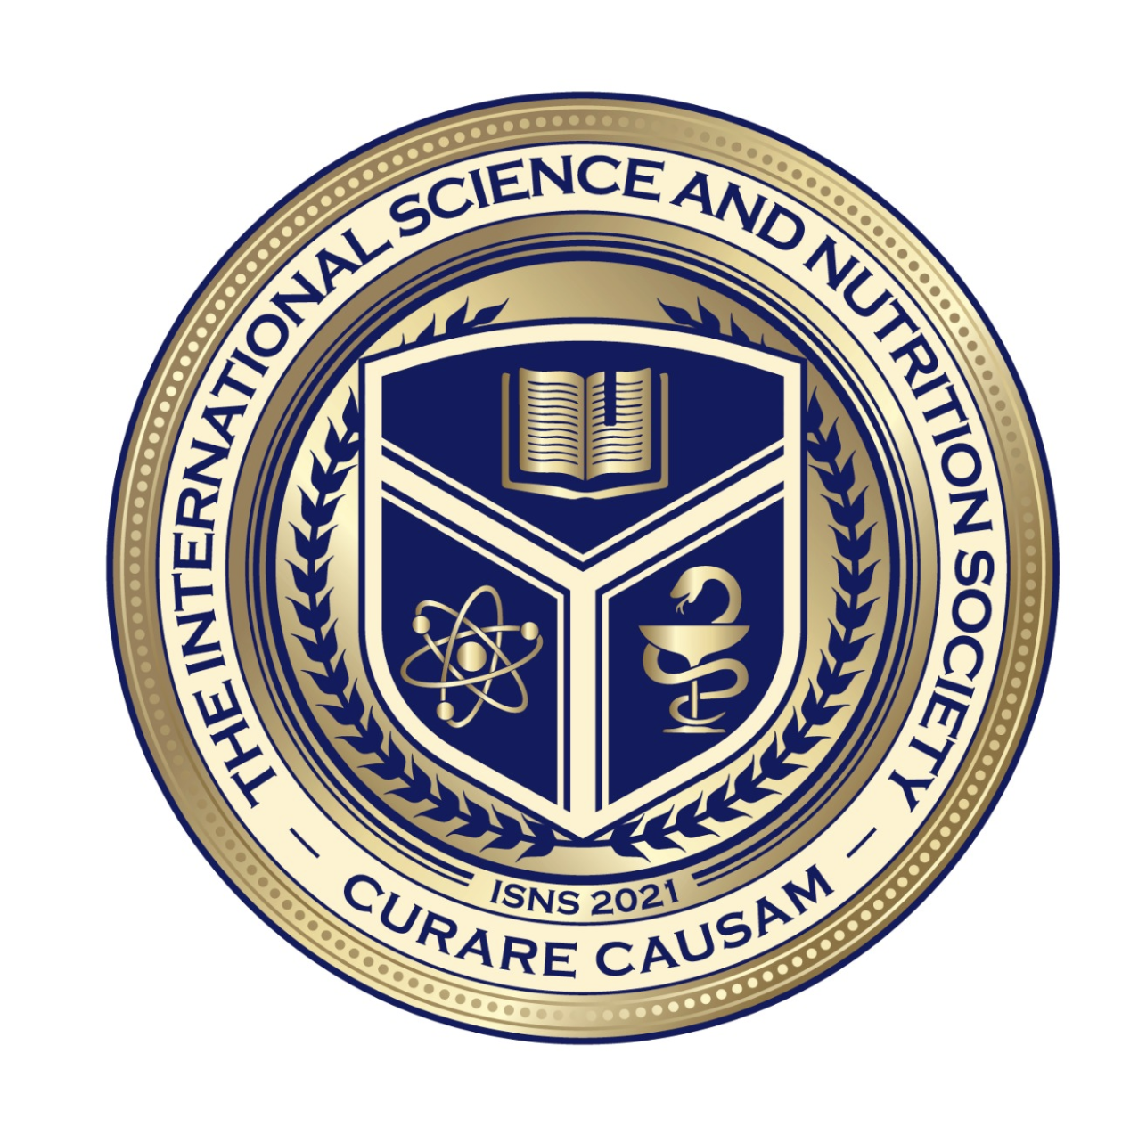
We will get started shortly.
International Science Nutrition Society – CURARE CAUSAM - ISNS 2023

Slide 2
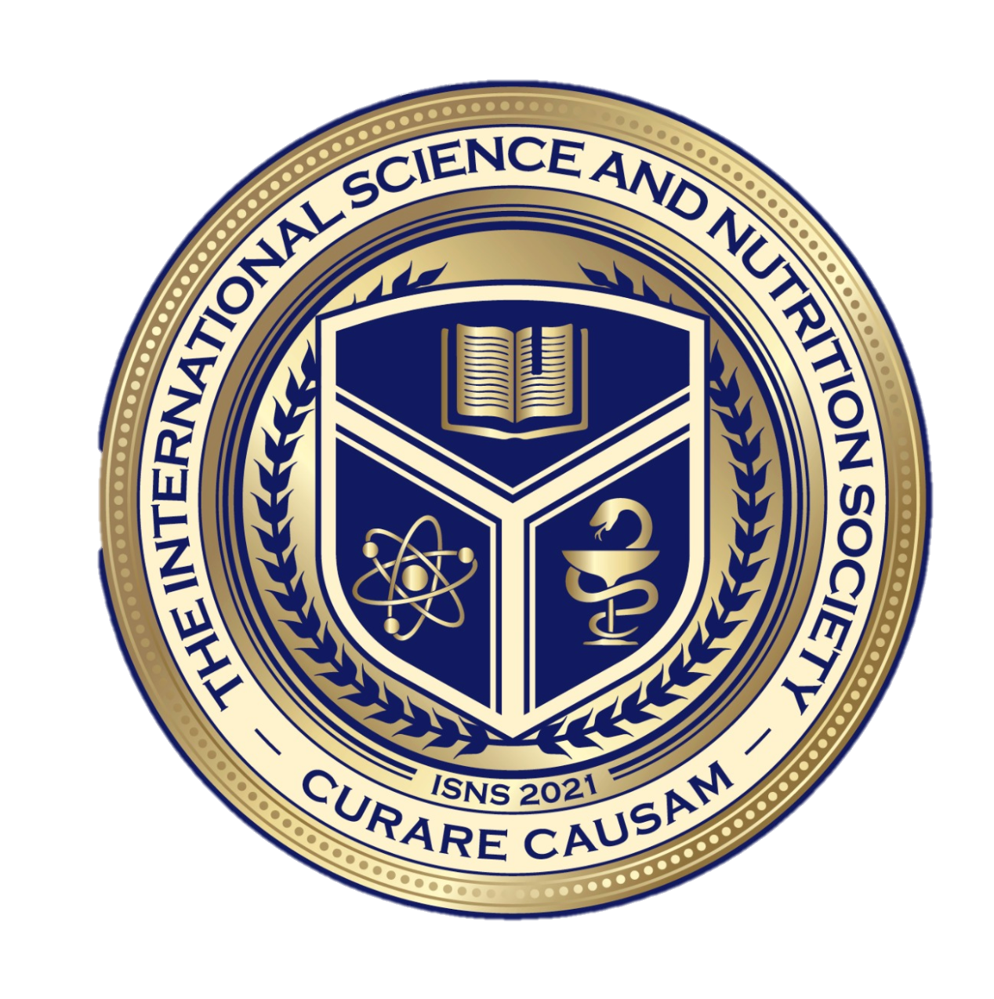
ISNS CASE STUDY
With Dr. Norbert Ketskes on Alzheimer’s Disease
International Science Nutrition Society – CURARE CAUSAM - ISNS 2023

Slide 3
Medical Disclaimer
The information provided is for educational purposes and is not intended as medical advice, or a substitute for the medical advice of a physician or other qualified health care professional. This is for science and educational purposes only and cannot be used in any aspect for sales or marketing. You should not use this information for diagnosing a health or fitness problem or disease. You should always consult with a doctor or other health care professional for medical advice or information about diagnosis and treatment. This is Confidential. Do not distribute—for scientific educational purposes only.
International Science Nutrition Society – CURARE CAUSAM - ISNS 2023

Slide 5
DR. NORBERT KETSKÉS, MD
Dr. Norbert Ketskés M.D. is one the most acknowledged gastroenterologists in Hungary, specializing in natural and organic nutritional solutions, leading the well-known Primus Labor, a private clinic offering personalized nutritional advice to its patients.
Scientific Adviser of ISNS
Medical Partner of the Hungarian Olympic Committee since 2015
Member of the Medical Board of the Hungarian Karate Association since 2015
Leader of the Primus Labor Private Medical Clinic since 2013
Working as a Family Doctor 1999 – 2012
International Science Nutrition Society – CURARE CAUSAM - ISNS 2023

Slide 6
CSISZTU ZSUZSA
Television - Presenter, Anchor, Editor, Journalist and Sports Lawyer, Sport-diplomat
Spokesperson of the Giro d’Italia Grande Partenza, (Road-Cycling World -Tour Championship)
Spokesperson of the FINA (Swimming and Waters poets World Championship)
2022 Vice-President of the Hungarian Sports Journalists’ Association
Member of the Hungarian Olympic Committee Member of the Advisory Board of the Hungarian Olympic Academy
Newly Elected Vice-President of the International Sports Journalists Association, the first female ever in the field from her homeland, and third globally since 1924 (AIPS)
International Science Nutrition Society – CURARE CAUSAM - ISNS 2023

Slide 7
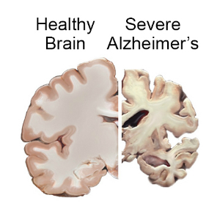
What is Alzheimer’s Disease?
Alzheimer’s Disease is the most common type of dementia. It is a progressive disease beginning with mild memory loss and possibly leading to loss of the ability to carry on a conversation and respond to the environment.
Alzheimer’s Disease involves parts of the brain that control thought, memory, and language. It can seriously affect a person’s ability to carry out daily activities.
About 6.5 million people in the US age 65 and older live with Alzheimer’s disease. Among them, more than 70% are 75 years old or older.
International Science Nutrition Society – CURARE CAUSAM - ISNS 2023

Slide 8
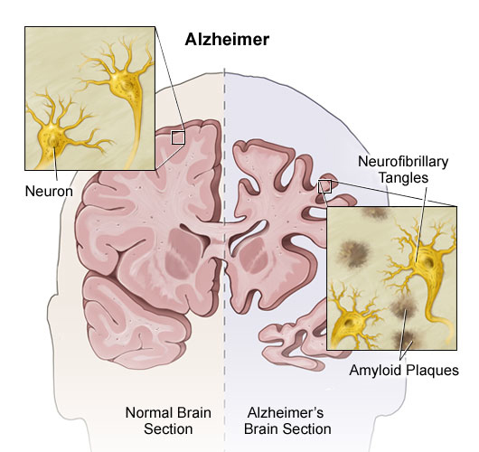
What Causes Alzheimer’s Disease?
Scientists don't yet fully understand what causes Alzheimer's disease in most people. The causes probably include a combination of age-related changes in the brain, along with genetic, environmental, and lifestyle factors.
The importance of any one of these factors in increasing or decreasing the risk of Alzheimer's disease may differ from person to person.
Alzheimer's disease is a progressive brain disease. It is characterized by changes in the brain—including amyloid plaques and neurofibrillary, or tau, tangles—that result in loss of neurons and their connections.
These and other changes affect a person’s ability to remember and think and, eventually, to live independently.
International Science Nutrition Society – CURARE CAUSAM - ISNS 2023

Slide 9
Aging and Alzheimer’s Risk
Older age does not cause Alzheimer’s, but it is the most important known risk factor for the disease. The number of people with Alzheimer’s disease doubles about every 5 years beyond age 65. About one-third of all people aged 85 and older may have Alzheimer's disease.
Scientists are learning how age-related changes in the brain may harm neurons and affect other types of brain cells to contribute to Alzheimer’s damage.
These age-related changes include atrophy (shrinking) of certain parts of the brain, inflammation, vascular damage, production of unstable molecules called free radicals, and breakdown of energy production within cells.
However, age is only one risk factor for Alzheimer’s disease. Many people live into their 90s and beyond without ever developing dementia
International Science Nutrition Society – CURARE CAUSAM - ISNS 2023

Slide 10
Signs and Symptoms of Alzheimer’s Disease
Memory problems are often one of the first signs of Alzheimer’s. Symptoms vary from person to person, and may include problems with:
Word-finding or having more trouble coming up with words than other people the same age.
Vision and spatial issues, like awareness of the space around them.
Impaired reasoning or judgment, which can impact decisions.
Other symptoms may be changes in the person’s behavior, including:
Taking longer to complete normal daily tasks.
Repeating questions.
Trouble handling money and paying bills.
Wandering and getting lost.
Losing things or misplacing them in odd places.
Mood and personality changes.
Increased anxiety and/or aggression.
International Science Nutrition Society – CURARE CAUSAM - ISNS 2023

Slide 11
Stages of Alzheimer’s Disease Alzheimer’s disease slowly gets worse over time. People with this disease progress at different rates and in several stages. Symptoms may get worse and then improve, but until an effective treatment for the disease itself is found, the person’s ability will continue to decline throughout the disease.
Early-stage Alzheimer’s is when a person begins to experience memory loss and other cognitive difficulties, though the symptoms appear gradually to the person and their family. Alzheimer’s disease is often diagnosed at this stage.
During middle-stage Alzheimer’s, damage occurs in areas of the brain that control language, reasoning, sensory processing, and conscious thought. People at this stage may have more confusion and trouble recognizing family and friends.
In late-stage Alzheimer’s, a person cannot communicate, is completely dependent on others for care, and may be in bed most or all the time as the body shuts down.
International Science Nutrition Society – CURARE CAUSAM - ISNS 2023

Slide 12
Alzheimer’s Disease and Genetics In most cases, Alzheimer’s does not have a single genetic cause. Instead, it is likely influenced by multiple genes in combination with lifestyle and environmental factors. Changes in genes, called genetic variations, may increase or decrease a person’s risk of developing the disease.
Scientists currently know of more than 70 genetic regions associated with Alzheimer’s. Of the genetic variants associated with Alzheimer’s so far, only three are known to cause the disease. Although it happens rarely, when someone inherits an altered version of one of these genes — APP, PSEN1, or PSEN2 — they will likely develop Alzheimer’s before age 65 and sometimes much earlier.
People with Down syndrome also have a higher risk of developing Alzheimer’s earlier in life. Down syndrome results from having an extra chromosome 21, which carries the APP gene that produces the amyloid precursor protein. Too much of this protein leads to a build-up of beta-amyloid plaques in the brain. Estimates suggest that 50% or more of people living with Down syndrome will develop Alzheimer’s with symptoms appearing in their 50s and 60s.
Another genetic variation, in the APOE gene, which has several forms, is known to influence the risk of Alzheimer’s. Specifically, APOE ε4 increases a person’s risk of developing Alzheimer’s and is also associated with developing Alzheimer’s earlier in life for certain populations. APOE ε2 may provide some protection against Alzheimer’s.
Changes in different genes, along with other biomedical, lifestyle, and environmental factors, play a role in potentially developing Alzheimer’s. Still, it is never known for certain if any individual will or will not develop the disease
International Science Nutrition Society – CURARE CAUSAM - ISNS 2023

Slide 13
CASE STUDY
Patient: Female
Age: 70
Medical history:
Alzheimer's disease was diagnosed 2 years ago
Clinical test:
The Mini-Mental State Examination (MMSE) is a 30-point, quick-to-take cognitive test that is mainly used to identify dementia and assess its severity in medical, clinical psychologist and neuropsychological practice.The interval from 30 to 29 is considered normal, points 27-28 may indicate a mild neurocognitive disorder, for those from 26 to 20 we assume mild dementia, from 19 to 10 moderate, and from 9 below severe we are talking about dementia.
In her case the result: 22
International Science Nutrition Society – CURARE CAUSAM - ISNS 2023

Slide 14
Conventional Treatment
Alzheimer’s is complex, and it is therefore unlikely that any one drug or other intervention will successfully treat it in all people living with the disease. In ongoing clinical trials, scientists are developing and testing several possible treatment interventions.
While there is currently no cure for Alzheimer’s, medications are emerging to treat the progression of the disease by targeting its underlying causes. Some medications may temporarily improve or stabilize memory and thinking skills in some people and may help manage certain symptoms and behavioral problems.
Additionally, people with Alzheimer’s may experience sleeplessness, depression, anxiety, agitation, and other behavioral and psychological symptoms. Scientists continue to research why these symptoms occur and are exploring new medications and non-drug strategies to manage them.
Research shows that treating these symptoms may make people with Alzheimer’s feel more comfortable and also help their caregivers. Antidepressants, antipsychotics, and anti-anxiety drugs may be helpful for some people with Alzheimer’s, but experts agree that these medicines should be used only after other strategies to promote physical and emotional comfort, such as avoiding stressful situations, have been tried. It’s important to talk with a doctor about what treatment will be most effective in your situation.
International Science Nutrition Society – CURARE CAUSAM - ISNS 2023

Slide 15
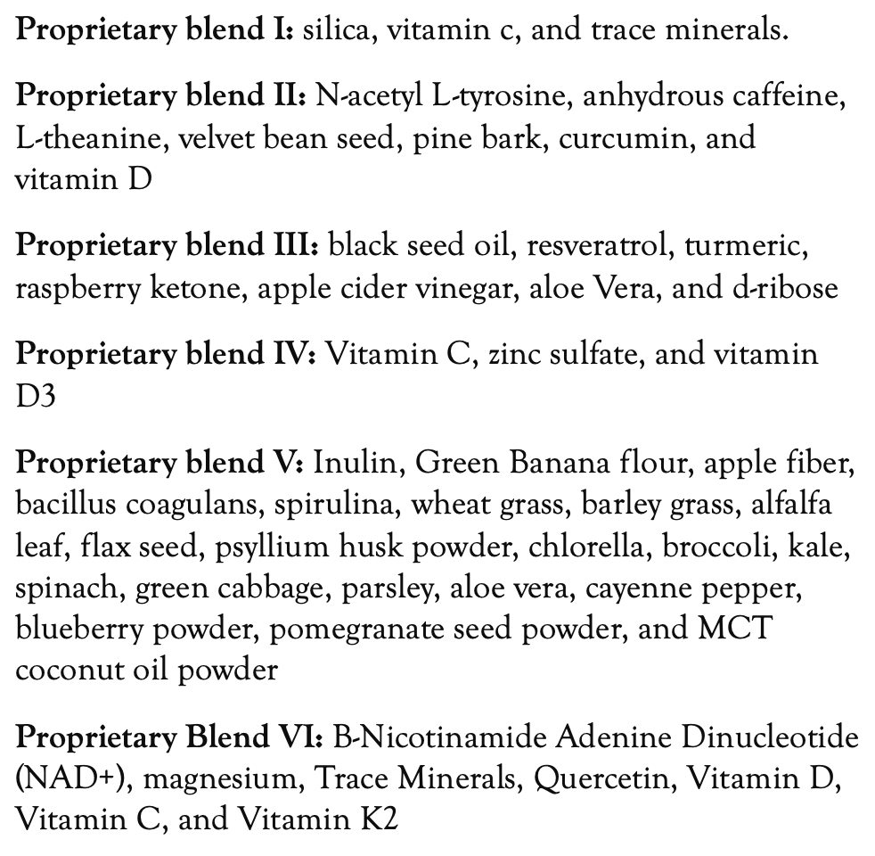
Method
PROPRIETARY BLENDS LEGEND
Proprietary blend I: 2x6 drops, morning and
evening, for 3 days, then every 3 days then
increased by 1-1 drops every 3 days to 2x12
Proprietary blend II :1 in the morning for 7 days, then 1 in the morning and 1 in the afternoon for 7 days, then 2 in the morning and 1 in the afternoon for 7 days, then 2 in the morning and 2 in the afternoon
Proprietary blend III: 1/2 sachet in the morning
for 7 days then 1 sachet in the morning
Proprietary blend IV: 1/2 teaspoon in the
morning for 7 days, then 1 teaspoon in the morning
Proprietary blend V: 1 teaspoon in the
in the evening
Proprietary blend VI: 1 in the
morning for 7 days then 1 in the morning and 1 in the evening for 7 days, then 2 in the morning and 1 in the evening
International Science Nutrition Society – CURARE CAUSAM - ISNS 2023

Slide 16
The ability to speak deteriorates, the ability to find information, the perception of time and the personality may also change.
There is currently no known traditional effective method for its treatment, but the quality of life can be improved.
A supportive family is indispensable, and in some cases even an expert nurse may be necessary!
International Science Nutrition Society – CURARE CAUSAM - ISNS 2023

Slide 17
Results
After 2 month :
The change was first reported by the family:
A slight improvement in speaking skills, the ability to find information, and the mood.
After 4 month:
Mini-Mental State Examination (MMSE): from 22 to 26!!!
Expressed improvement in speaking skills, ability to find information, perception of time and mood.
And not only the family, but also the patient could report on the improvement.
Based on these, the patient's quality of life improved!
International Science Nutrition Society – CURARE CAUSAM - ISNS 2023

Slide 18
Research Studies
International Science Nutrition Society – CURARE CAUSAM - ISNS 2023

Slide 19
Curcumin in Health and Diseases: Alzheimer’s Disease and Curcumin Analogues, Derivatives, and Hybrids Eirini Chainoglou and Dimitra Hadjipavlou-Litina*
Curcumin, which is the principal component of Curcuma longa, has shown favorable effects for significantly preventing or treating AD. During the last decade, the scientific community has focused its research on the optimization of therapeutic properties and the improvement of the pharmacokinetic properties of curcumin.
This review summarizes bibliographical data from 2009 to 2019 on curcumin analogs, derivatives, and hybrids, as well as their therapeutic, preventive, and diagnostic applications in AD.
Recent advances in the field have revealed that the phenolic hydroxyl group could contribute to the anti-amyloidogenic activity. Phenyl methoxy groups seem to contribute to the suppression of amyloid-β peptide (Aβ₄₂) and the suppression of amyloid precursor protein (APP) and hydrophobic interactions have also revealed a growing role. Furthermore, flexible moieties, at the linker, are crucial for the inhibition of Aβ aggregation. The inhibitory activity of derivatives is increased with the expansion of the aromatic rings.
The promising role of curcumin-based compounds in diagnostic imaging is highlighted. The keto-enol tautomerism seems to be a novel modification for the design of amyloid-binding agents. Molecular docking results, (Q)SAR, as well as in vitro and in vivo tests highlight the structures and chemical moieties that are correlated with specific activity. As a result, the knowledge gained from the existing research should lead to the design and synthesis of innovative and multitargeted curcumin analogs, derivatives, or curcumin hybrids, which would be very useful drugs and tools in medicine for both diagnosis and treatment of AD.
International Science Nutrition Society – CURARE CAUSAM - ISNS 2023

Slide 20
Molecular signaling pathway targeted therapeutic potential of thymoquinone in Alzheimer’s disease Fabiha Zaheen Khan,ª Md Shaki Mostaid,^{b} and Mohd Nazmul Hasan Apu^{a,∗}
Alzheimer’s disease (AD) is a neurodegenerative disease with rapid progression. Black cumin (Nigella sativa) is a nutraceutical that has been investigated as a prophylactic and therapeutic agent for this disease due to its ability to prevent or retard the progression of neurodegeneration.
Thymoquinone (TQ) is the main bioactive compound isolated from the seeds of black cumin. Several reports have shown that it has promising potential in the prevention and treatment of AD due to its significant antioxidative, anti-inflammatory, and antiapoptotic properties along with several other mechanisms that target the altered signaling pathways due to the disease pathogenesis.
In addition, it shows anticholinesterase activity and prevents α-synuclein induced synaptic damage. The aim of this review is to summarize the potential aspects and mechanisms by which TQ imparts its action in AD.
International Science Nutrition Society – CURARE CAUSAM - ISNS 2023

Slide 21
Vitamin D Improves Neurogenesis and Cognition in a Mouse Model of Alzheimer’s Disease Maria Morello, Verena Landel, Emmanuelle Lacassagne, Kevin Batanger, Cedric Annweiler, Francois Feron, and Pascal Millet
The impairment of hippocampal neurogenesis at the early stages of Alzheimer’s disease (AD) is believed to support early cognitive decline. Converging studies sustain the idea that vitamin D might be linked to the pathophysiology of AD and to hippocampal neurogenesis. Nothing is known about the effects of vitamin D on hippocampal neurogenesis.
Male wild-type and transgenic AD-like mice (5XFAD model) were fed with a diet containing either no vitamin D (0VD) or a normal dose of vitamin D (NVD) or a high dose of vitamin D (HVD), from month 1 to month 6 (preventive arm) or from month 4 to month 9 (curative arm). Working memory was assessed using the Y-maze, while amyloid burden, astrocytosis, and neurogenesis were quantified using immunohistochemistry. In parallel, the effects of vitamin D on proliferation and differentiation were assayed on primary cultures of murine neural progenitor cells. in AD, we assessed them in a mouse model of AD.
Improved working memory and neurogenesis were observed when high vitamin D supplementation was administered during the early phases of the disease, while a normal dose of vitamin D increased neurogenesis during the late phases. Conversely, an early hypovitaminosis D increased the number of amyloid plaques in AD mice while a late hypovitaminosis D impaired neurogenesis in AD and WT mice.
Finally, a sexual dimorphism was observed. Vitamin D supplementation improved the working memory of males and females when delivered during the pre-symptomatic and symptomatic phases, respectively. Our study establishes that (i) neurogenesis is improved by vitamin D in a male mouse model of AD, in a time-dependent manner, and (ii) cognition is enhanced in a gender-associated way. Additional pre-clinical studies are required to further understand the gender- and time-specific mechanisms of action of vitamin D in AD. This may lead to an adaptation of vitamin D supplementation to the patient’s gender and age as well as to the stage of the disease.
International Science Nutrition Society – CURARE CAUSAM - ISNS 2023

Slide 22
Heavy Metals Exposure and Alzheimer’s Disease and Related Dementias Kelly M. Bakulski,^{a,1,*} Young Ah Seo,^{b,1} Ruby C. Hickman,ª Daniel Brandt,ª Harita S. Vadari,ª Howard Hu,^{c} and Sung KyunParkª
Alzheimer’s disease and related dementias lack effective treatment or cures and are major public health challenges. Risk for Alzheimer’s disease and related dementias is partially attributable to environmental factors. The heavy metals lead, cadmium, and manganese are widespread and persistent in our environments.
Once persons are exposed to these metals, they are adept at entering cells and reaching the brain. Lead and cadmium are associated with numerous health outcomes even at low levels of exposure. Although manganese is an essential metal, deficiency or environmental exposure or high levels of the metal can be toxic. In cell and animal model systems, lead, cadmium, and manganese are well-documented neurotoxicants that contribute to canonical Alzheimer’s disease pathologies.
Adult human epidemiologic studies have consistently shown lead, cadmium, and manganese are associated with impaired cognitive function and cognitive decline. No longitudinal human epidemiology study has assessed lead or manganese exposure to Alzheimer’s disease specifically though two studies have reported a link between cadmium and Alzheimer’s disease mortality.
More longitudinal epidemiologic studies with high-quality time course exposure data and incident cases of Alzheimer’s disease and related dementias are warranted to confirm and estimate the proportion of risk attributable to these exposures.
Two human studies using data from the US NHANES reported a possible link between cadmium exposure and AD mortality. Though lead, cadmium, and manganese have characterized neuronal toxicological pathways, cause AD-related pathology and memory deficits in model systems and are associated with declines in cognition in older adults, evidence in humans linking these to AD is very limited. More longitudinal epidemiologic studies with high-quality time course exposure data and incident cases of AD are warranted to confirm and estimate the proportion of risk attributable to these exposures.
Older adults are poised to experience lead-, cadmium-, and manganese-related accelerated declines in cognition as they age. Given the widespread and global exposure to lead, cadmium, and manganese, even small increases in the risks of AD and related dementias would have a major population impact on the disease burden. Exposure management should be considered to reduce the risks of AD and related dementias that may be attributable to exposure to lead, cadmium, or manganese. Modifying exposure levels to the known neurotoxicants and suspected AD and related dementia risk factors, lead, cadmium, and manganese, should be a public health priority to prevent disease
International Science Nutrition Society – CURARE CAUSAM - ISNS 2023

Slide 23
References
https://www.alzheimers.gov/alzheimers-dementias/alzheimers-disease
https://www.nia.nih.gov/health/alzheimers-and-dementia/alzheimers-disease-fact-sheet
https://www.ncbi.nlm.nih.gov/pmc/articles/PMC7139886/
https://www.ncbi.nlm.nih.gov/pmc/articles/PMC9272348/
https://www.ncbi.nlm.nih.gov/pmc/articles/PMC6061182/
https://www.ncbi.nlm.nih.gov/pmc/articles/PMC7454042/
International Science Nutrition Society – CURARE CAUSAM - ISNS 2023

Slide 24
Thank You for Joining Us This Week!!
International Science Nutrition Society – CURARE CAUSAM - ISNS 2023

